Slide 1

L1 Regularization - get_tensor_by_name

Slide 2

Reference
Chapter 11 (O'Reilly) of Hands-On ML
Youtube
Code

Slide 3
Data

Slide 4
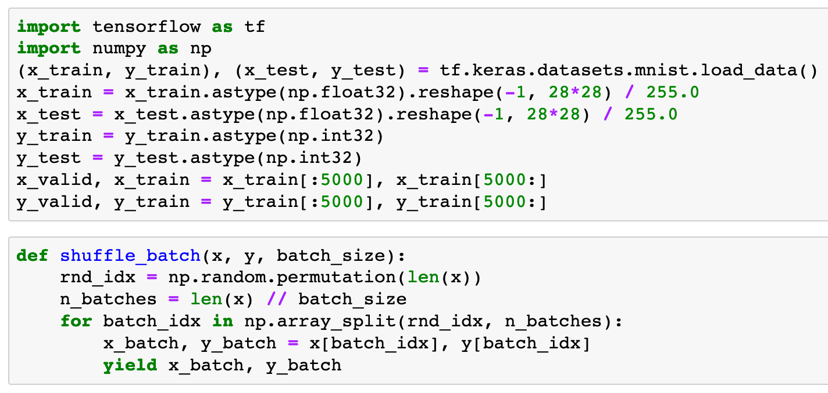


Slide 6
Warm Up

Slide 7
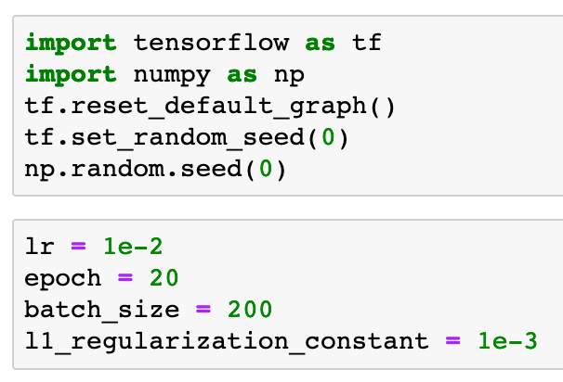

Slide 9
Part of Graph

Slide 10
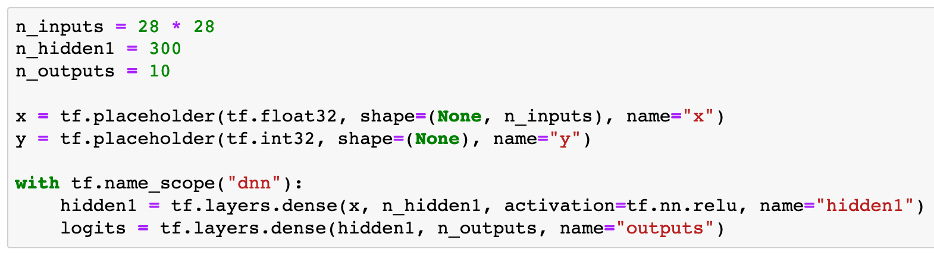

Slide 11
How to get Handle of Weights

Slide 12
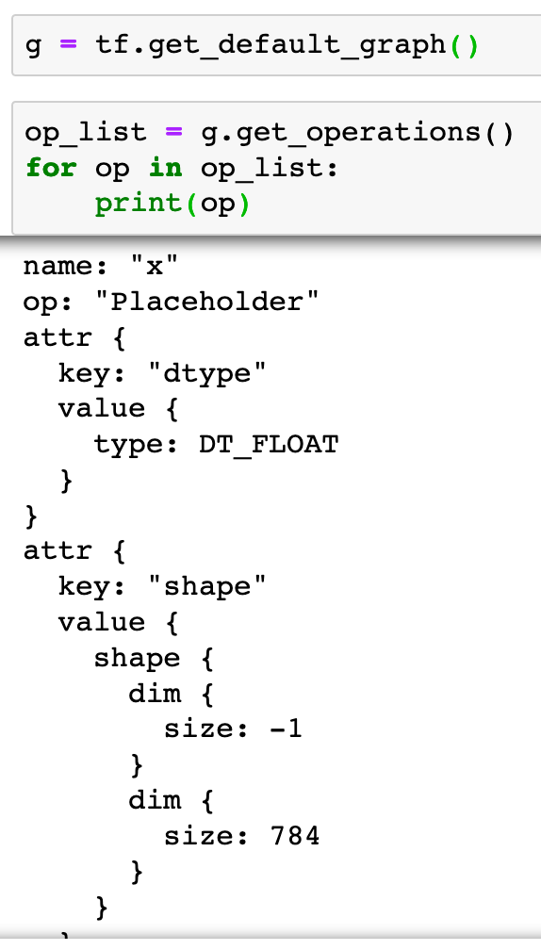

Slide 14
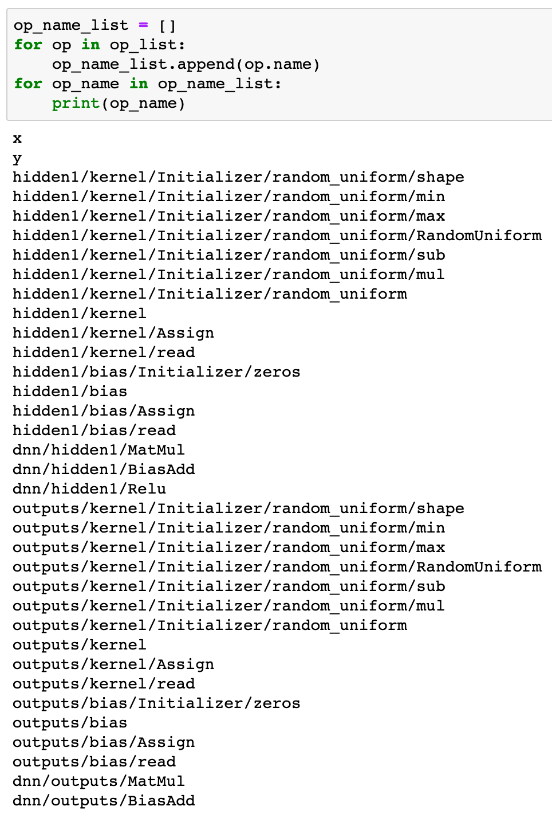

Slide 15
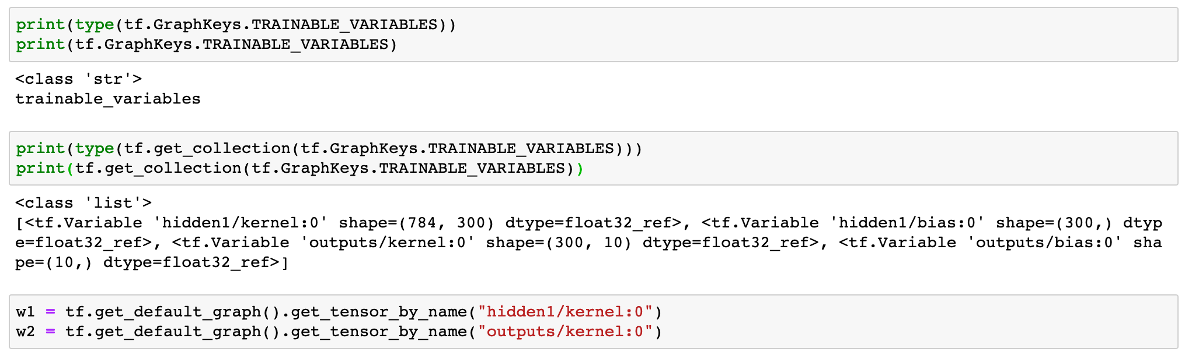

Slide 18
Continue to build Graph

Slide 19
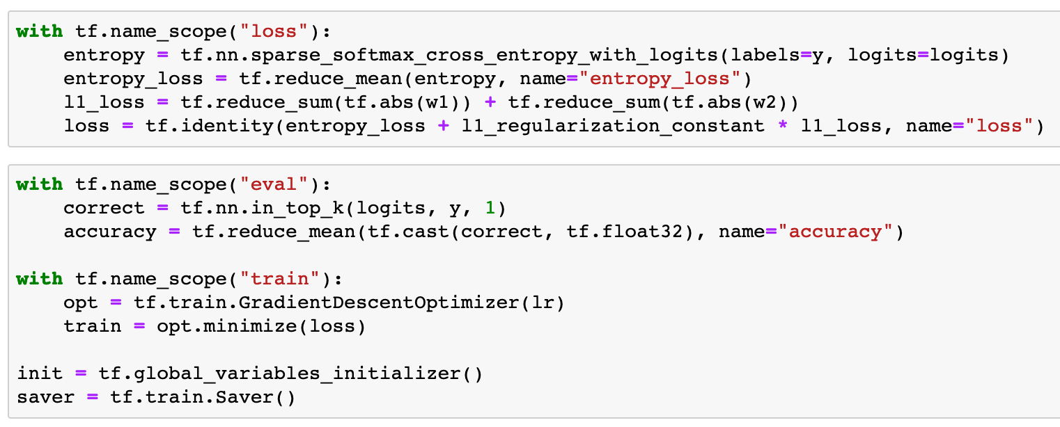

Slide 21
Session

Slide 22
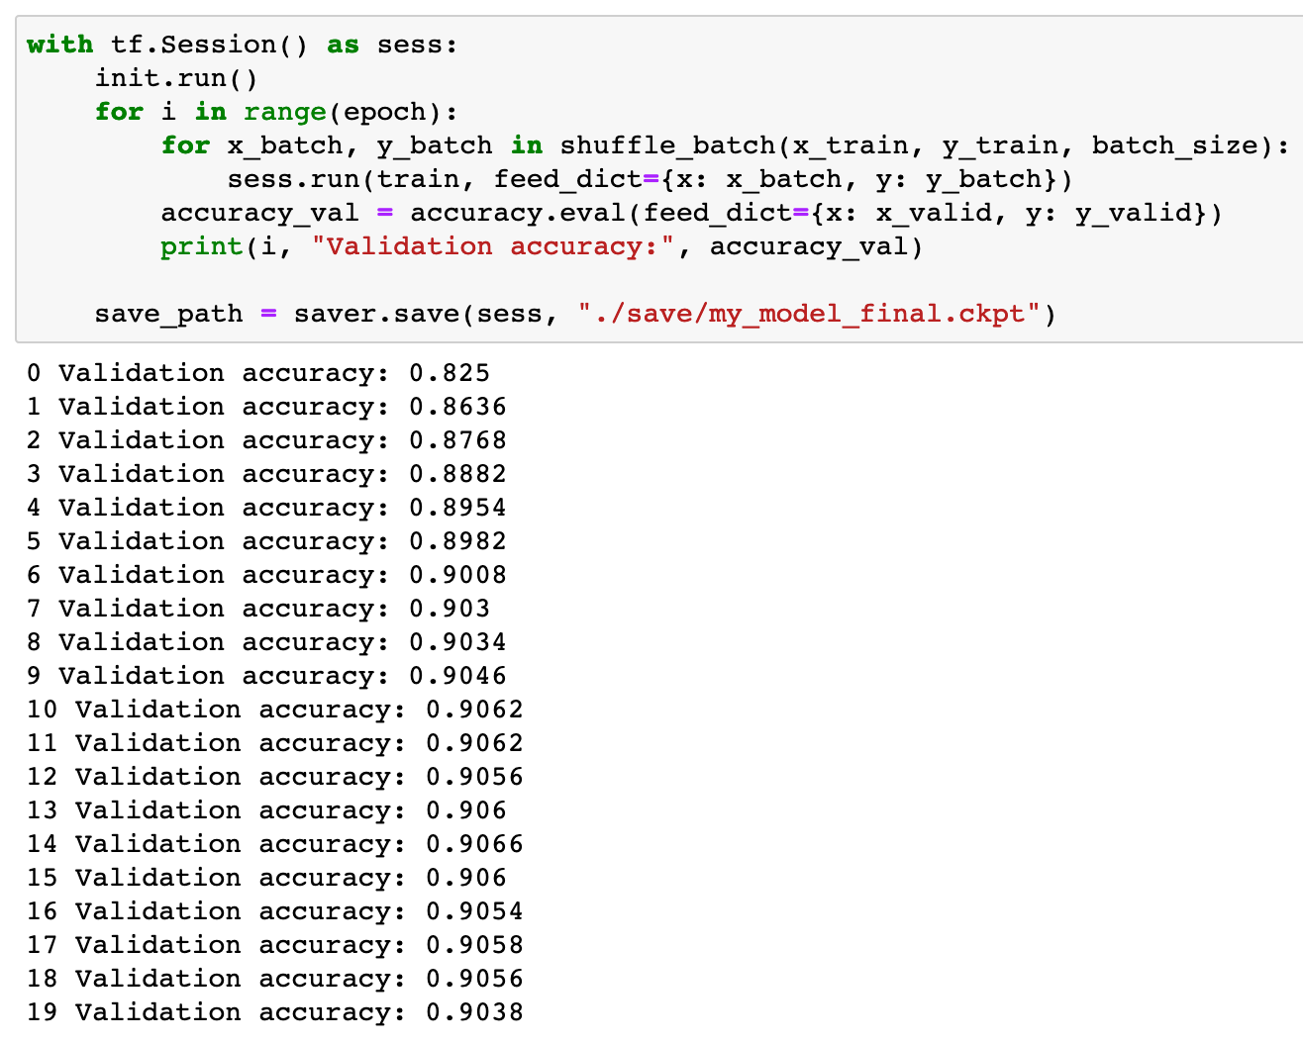

Slide 23
Now
Let’s Play with Code

